Slide 1
User Profile Template
Click to start presentation

Slide 2
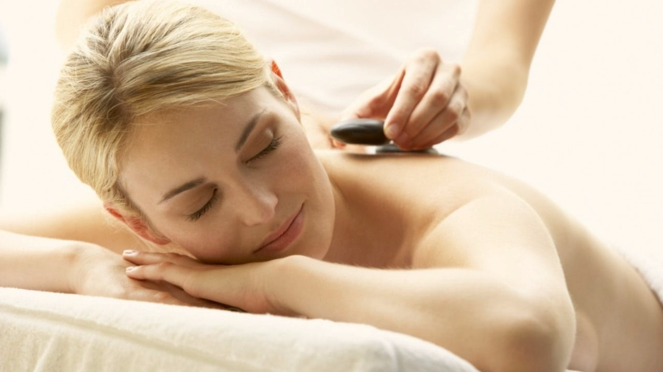

Home
Bookings
About us
Services
Contacts
Profile
Sign out
Germany Mobile Spa
Relax. Rejuvenate. Renew.
Discover the healing power of touch. Our expert massage therapies not only melt away stress but also improve circulation, relieve muscle tension, and promote overall well-being. Invest in your health —because you deserve it.
Find your closest therapist

Slide 3


Home
Bookings
About us
Services
Contacts
Profile
Sign out
Germany Mobile Spa
Personal Details
Preferred Locations
Profile picture
First name*
Last name*
Sex*
Age*
Stephany
Anniston
Female
25
Preferences
Full address*
Payment Settings
Kitaibelite 30, Berlin 10034
Notification Settings
Email address*
Phone number*
Upload new
Delete
XXXXXXXXXXXX@gmail.com
+49 XXX XXX XXXX
Booking History
Pronouns:
Privacy and Security
She/Her
My reviews
Customer Support
Save Changes
Discard Changes

Slide 4

Home
Bookings
About us
Services
Contacts
Profile
Sign out
Germany Mobile Spa
Profile picture
First name*
Last name*
Sex*
Age*
Personal Details
Default location
Rosenweg 5, 80331 München
Preferred Locations
Preferences
Enter new address
All locations
Potsdamer Strasse 4, Hamburg 22149
Add
Payment Settings
Rosenweg 5, 80331 München
Edit
Default location
Remove location
Notification Settings
Lindenallee 7, 40210 Düsseldorf
Edit
Use as default location
Remove location
Hauptstraße 12, 10115 Berlin
Edit
Use as default location
Remove location
Booking History
Am Markt 14, 28195 Bremen
Edit
Use as default location
Remove location
Privacy and Security
Sonnenstraße 30, 01067 Dresden
Edit
Use as default location
Remove location
My reviews
Customer Support
Save Changes
Discard Changes

Slide 5
Home
Bookings
About us
Services
Contacts
Profile
Sign out
Germany Mobile Spa
Profile picture
First name*
Last name*
Sex*
Age*
Personal Details
Preferred Locations
Therapist Preferences
Preffered sex
Male
Female
No Preference
Preferences
Payment Settings
Treatment Preferences
Select a preffered massage / massages
Notification Settings
Thai Massage
Myofascial Massage
Facial Treatment
Relaxing Oil Massage
Pregnancy Massage
Manicure
Booking History
Deep Tissue Massage
Foot Massage
Pedicure
Privacy and Security
Slimming Massage
Foot Scrub
Yoga Personal Training
Jet Lag Recovery Massage
Body Scrub
My reviews
Preffered session lenght
60 mins
90 mins
120 mins
No Preference
Customer Support
Notes to therapist
I have a lot of back pain and I need you to be careful
Up to 500 characters
Save Changes
Discard Changes

Slide 6
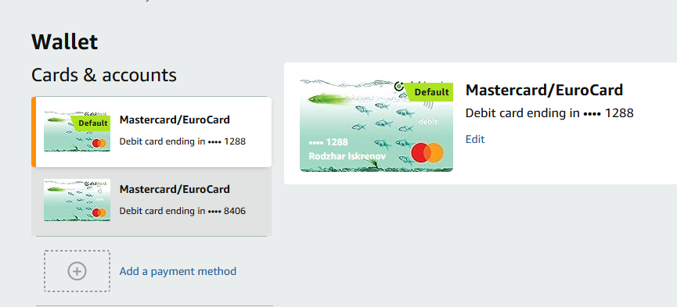
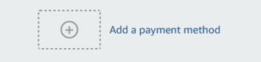
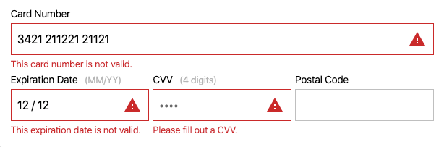
Home
Bookings
About us
Services
Contacts
Profile
Sign out
Germany Mobile Spa
Profile picture
First name*
Last name*
Sex*
Age*
Personal Details
Preferred Locations
Cards & accounts
Billing history
Add debit/credit card
Add bank account
Add PayPal account
Preferences
Add Google Pay account
Add Apple Pay account
Payment Settings
Full name of bank account holder
Bank name
Anna Müller
Deutsche Bank
Notification Settings
Street Number Postcode
Blumenstraße
23
10115
City
Country
Booking History
Berlin
Berlin
Bank account number
Privacy and Security
1234567890
IBAN – Bank account number
DE89 1007 0000 1234 5678 90
My reviews
SWIFT Code (BIC)
Customer Support
DEUTDEBBXXX
Auto-payment
Turn on
Turn off
Save Changes
Discard Changes

Slide 7
Home
Bookings
About us
Services
Contacts
Profile
Sign out
Germany Mobile Spa
Profile picture
First name*
Last name*
Sex*
Age*
Personal Details
Preferred Locations
All notifications
Turn on
Turn off
Mute
Notification preferences
Push
SMS
Email
Preferences
Payment Settings
Notification Settings
Booking History
Privacy and Security
My reviews
Customer Support
Save Changes
Discard Changes

Slide 8
Home
Bookings
About us
Services
Contacts
Profile
Sign out
Germany Mobile Spa
Profile picture
First name*
Last name*
Sex*
Age*
Personal Details
Preferred Locations
Search by name, service, location, duration, price
Search
Preferences
Payment Settings
Therapist name
Service
Location
Date
Duration
Price (€)
Notification Settings
Anna Müller
Thai massage
Rosenweg 5, 80331 München
07/01/2025
60 mins
25
Maximilian Schmidt
Foot massage
Lindenallee 7, 40210 Düsseldorf
35
24/03/2024
90 mins
Emma Fischer
Pregnancy massage
Hauptstraße 12, 10115 Berlin
07/06/2025
60 mins
25
Booking History
Leon Wagner
Body scrub
Am Markt 14, 28195 Bremen
19/08/2025
120 mins
65
Yoga personal training
Sonnenstraße 30, 01067 Dresden
Sophia Meyer
30/11/2024
90 mins
75
Privacy and Security
My reviews
Customer Support

Slide 9
Home
Bookings
About us
Services
Contacts
Profile
Sign out
Germany Mobile Spa
Profile picture
First name*
Last name*
Sex*
Age*
Personal Details
Hide Profile from Public View
Turn off
Turn on
Preferred Locations
Preferences
Password*
Confirm Password*
Payment Settings
Update Password
***************
***************
Notification Settings
Save Password
Forgotten Password
Booking History
Request account data download
Request account data deletion
Privacy and Security
Delete account
My reviews
Customer Support
Save Changes
Discard Changes

Slide 10
Home
Bookings
About us
Services
Contacts
Profile
Sign out
Germany Mobile Spa
Profile picture
First name*
Last name*
Sex*
Age*
Personal Details
Preferred Locations
Search by name, service
Search
Preferences
Therapist name
Service
Review
Rating
Anna Müller
Thai massage
This was the best thai massage of my life
4/5
Payment Settings
Maximilian Schmidt
Foot massage
The lady knows what shes doing
4/5
Notification Settings
Booking History
Privacy and Security
My reviews
Customer Support

Slide 11
Home
Bookings
About us
Services
Contacts
Profile
Sign out
Germany Mobile Spa
Profile picture
First name*
Last name*
Sex*
Age*
Personal Details
Preferred Locations
FAQ
Where can I see my previous bookings? How to access the payments settings?
How to delete my account?
Where to see my previous therapists?
Preferences
Payment Settings
Notification Settings
You don‘t see the answers you are looking for?
Write us an email
Topic
Booking History
Privacy and Security
My reviews
Up to 2000 letters
Send email
Discard text
Customer Support
You can also call us on one of the following numbers:
+49 1242424893 or +49 15254429321

